Slide 1

Geoffrey Hill, Tutamantic
Let’s talk about (rapid) threat model prototyping

Slide 2
License for use
This work is licensed under the Creative Commons Attribution-NonCommercial-ShareAlike 4.0 International License. To view a copy of this license, visit http://creativecommons.org/licenses/by-nc-sa/4.0/ or send a letter to Creative Commons, PO Box 1866, Mountain View, CA 94042, USA.
https://creativecommons.org/licenses/by-nc-sa/4.0/legalcode

Slide 3
Who is this guy?!?

Slide 4
Ran around…
Will code for food
the world, being a developer in mid-late 90s

Slide 5
Started with…
Microsoft in 2002, jumped into appSec right away
Developed a…
SDL for customers using Agile in 2004 at Microsoft UK

Slide 6
Worked with…
Visa Europe for 4 years as the only appSec architect

Slide 7

Founder of Tutamantic

Slide 8
Let’s roll…
What should Threat Modeling (TM) do?
What it doesn’t do 😐
Overview of secure Agile Architecture
Introduction to Rapid TM prototyping

Slide 9
What should threat modeling do?!?

Slide 10
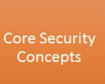
Threat Modeling should apply SSDLC principles
secure by design
Defense in depth
Secure by default
Principle of Identity
Principle of Least privilege
Secure in deployment
Endpoints and Ports
Communication protocols

Slide 11
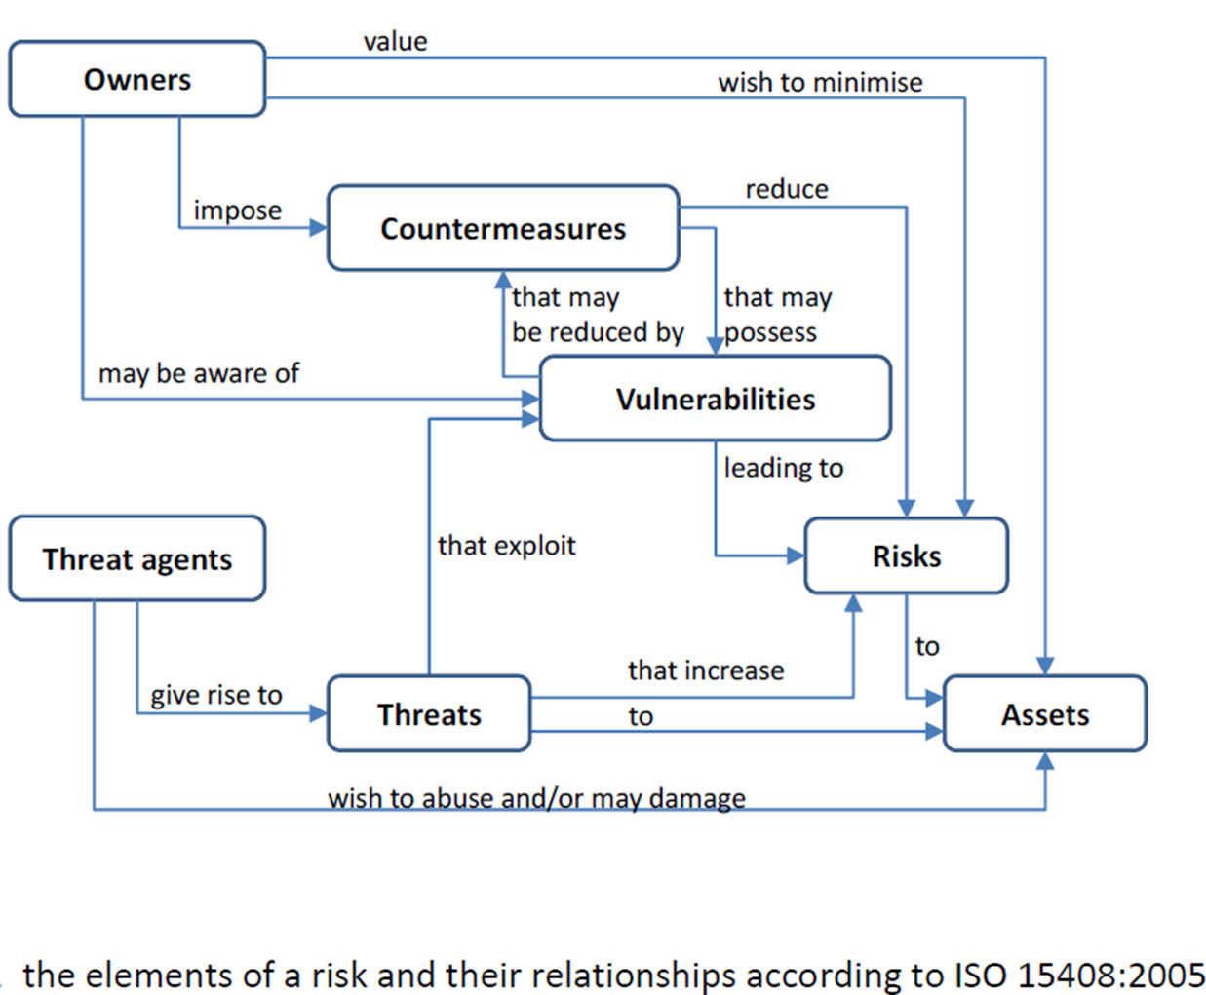
Threat Modeling should map these relationships graphically

Slide 12
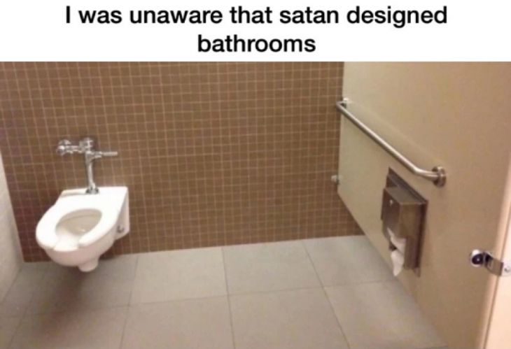
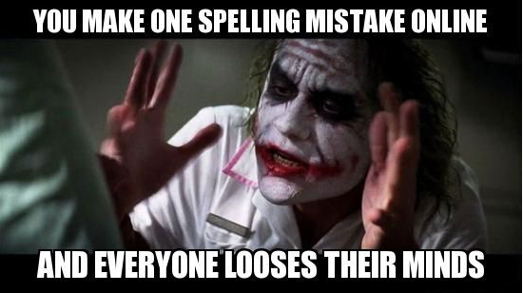
Threat Modeling should expose Flaws versus bugs
Notes:
Flaws are design-time mistakes that generally lead to a number of security issues and are difficult to fix because of dependencies, eg. Not planning access control on certain objects in the design, planning a poor security authentication pattern.
Bugs happen during implementation… developers introduce bugs when their code doesn’t take into account all the potential actions that can exist. Example would be to concatenate user input into html, causing a Cross-site scripting (XSS) issue.

Slide 13
Understand Zones of trust
Dependencies
Model
Analyse Threats
Analyse Mitigations
Validate
Threat Model
Static code review
Use threat framework
Testing
Security Control mismatches
Accept
Reduce
(Use Security Requirements)

Slide 14
What Threat Modeling actually gives us (FAIL)

Slide 15
Too much time spent on THREATS…
not enough time on MITIGATIONS!

Slide 16
Messy data flow diagrams
Vague trust boundaries
Request / response issues
Notes:
Vague trust boundaries that cannot be quantified.

Slide 17
Does this reflect the design?
Requires a security expert to interpret
Hard to keep DFD and software design in synch
Notes:
And ultimately messy, silly and unmaintainable
HINT – YOU’RE GOING TO GET IT WRONG

Slide 18
All the demands of your time

Slide 19
Oeh noez!!!
FINAL SPRINT!!!
Too much time trying for a complete model
Notes:
Finally… getting the model out in time… oh no, it’s the final sprint ☹

Slide 20
Solution… use secure Agile architecture principles!

Slide 21
Use strategic Agile Architecture
Intentional architecture
Consistency across changing environments
Enabling cross-team design
reduces inconsistencies
Maps business objectives to technical business requirements
Notes:
Intentional architecture
needed where many changes happen in many environments
provides a framework for cross-team design and implementation synchronization
reduces the production of redundant and/or conflicting code and designs

Slide 22
Agile Architecture in the teams
Emergent design
Organically grown by team
Continuous Integration and Testing steps
Use business technical requirements mapped to Security Requirements (SAMM)
Notes:
Emergent design
Grown incrementally by those who are closest
Evolves by constant testing and Continuous Integration steps
Design grows in accordance with the currently known requirements

Slide 23
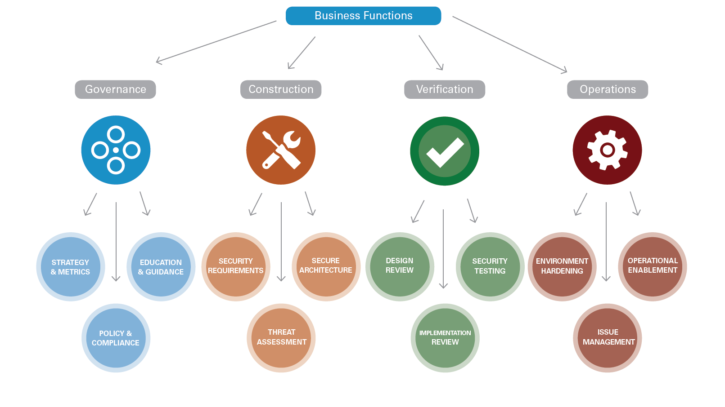
SAMM

Slide 24

Quick review of rapid prototyping
Identify basic requirements
Conceptual Design
test the prototype and provide feedback
Revise and enhance

Slide 25
Rapid Threat model Prototyping (RTMP)
CONSISTENT framework
REPEATABLE process
MEASURABLE data
For CI/CD & DevOps
Notes:
Make inputs and outputs consistent to enable inclusion in an automated CI/CD & DevOps environment

Slide 26
Rapid Threat model prototyping - purpose
Start the conversation
80/20 rule
Just-enough information
Not comprehensive… initially
Notes:
Remember the purpose of rapid prototyping… to start a conversation, not create a complete in-depth threat and mitigation listing!

Slide 27
Introduction to Rapid TM prototyping

Slide 28
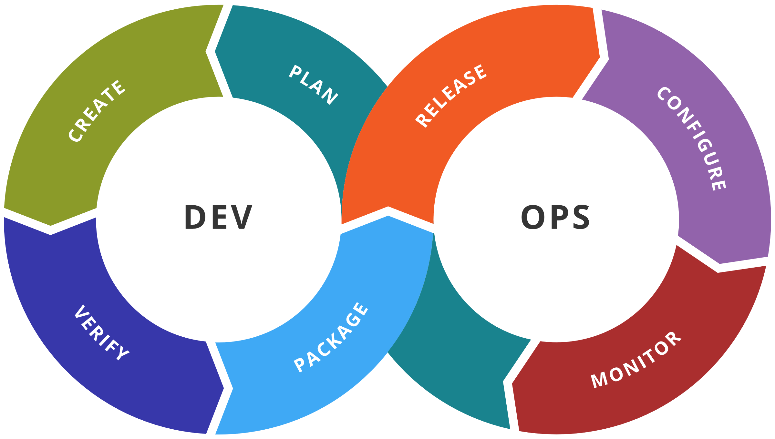
Let’s break it down by devops steps

Slide 29
Use a common security framework
to communicate issues across groups

Slide 30
Notes:
In digital security, non-repudiation means:
A service that provides proof of the integrity and origin of data.
An authentication that can be said to be genuine with high confidence

Slide 31
AUTHENTICATION ~ INTEGRITY
Notes:
In digital security, non-repudiation means:
A service that provides proof of the integrity and origin of data.
An authentication that can be said to be genuine with high confidence

Slide 32
Build on a current context or process diagram (model storming)
Save TM data in these diagrams
Run TM through process per diagram change
Model Storming to adapt new requirements
No data duplication
Notes:
Find a representative context or process diagram with help from the relevant architect/designer
Model storming at beginning of sprint – define work items in diagram
You don’t need Ack/Nack flows! Same protocol over same communication = same threat vectors!
Put in a process to upload the diagram into the DevOps process on each diagram change. The TM will show the differences (lack of data or added metadata)

Slide 33



Example diagram (REAL SYSTEM though)
DOWN
LOADER
RESULTS DATA
website
UPLOADER
PARSING
API GATEWAY
3rd party
DATA PROCESS
ANALYSIS
BLOB STORAGE
ANALYSIS RULES

Slide 34
Elevation of privilege / access control
is the most dangerous!!!
Notes:
Why you want to identify Elevation of Privilege threats first… the most dangerous attack step is the C&C step.

Slide 35
Discover the Zones of Trust
ADD ZONES during sprint 0 or pre-sprint
Find Elevation of Privilege issues quickly
Most time should be spent on this
Think of it as measuring security impact

Slide 36
Guidance
Build Defense-In-Depth focused on the diagram design
Any inbound communication is OUTSIDE diagram’s control
This includes internal communication
Zones should be valued between 0 - 9

Slide 37
Trust Rule – make entities outside control value of 0
DOWN
LOADER
RESULTS DATA
0
website
UPLOADER
PARSING
API GATEWAY
0
3rd party
DATA PROCESS
ANALYSIS
BLOB STORAGE
ANALYSIS RULES

Slide 38
Trust Guidance – make entities where data hits the disk as the highest values
9
DOWN
LOADER
RESULTS DATA
0
website
UPLOADER
PARSING
API GATEWAY
0
3rd party
DATA PROCESS
ANALYSIS
8
BLOB STORAGE
ANALYSIS RULES
7

Slide 39
Trust Guidance – boundary entities are usually 1 (low trust)
9
DOWN
LOADER
RESULTS DATA
1
0
1
website
UPLOADER
PARSING
API GATEWAY
0
3rd party
DATA PROCESS
ANALYSIS
8
BLOB STORAGE
ANALYSIS RULES
7

Slide 40
Trust Guidance – all the other entities will fall within the range
9
6
RESULTS DATA
5
DOWN
LOADER
1
0
1
website
2
UPLOADER
PARSING
4
API GATEWAY
0
3rd party
DATA PROCESS
4
ANALYSIS
6
Guide team with help from Security Champion
8
BLOB STORAGE
ANALYSIS RULES
7
Notes:
This activity will take the longest time.

Slide 41
Apply Zone rules
(calculate base attack patterns)
Use shorthand – letters of the STRIDE mnemonic
Rules are meant to kickstart analysis process
Diagram provides description for threats
Don’t spend too much time on threats
Our job is to sort out MITIGATIONS!!!
Notes:
Rules are meant as a kickstart to get you started

Slide 42
Zone Rule – first ELEVATION OF PRIVILEGE threats
E
E
9
E
5
6
RESULTS DATA
DOWN
LOADER
1
0
1
website
E
2
UPLOADER
PARSING
4
API GATEWAY
0
3rd party
E
DATA PROCESS
4
ANALYSIS
6
E
E
E
8
Target element
Low value > High value
E
BLOB STORAGE
ANALYSIS RULES
7
Notes:
This activity will take the longest time.

Slide 43
Zone rule – SPOOFING threats
E
E
9
E
5
6
RESULTS DATA
DOWN
LOADER
1
0
1
website
SE
2
UPLOADER
PARSING
4
API GATEWAY
0
3rd party
E
DATA PROCESS
4
ANALYSIS
6
E
SE
E
8
Target element
Less than 1 > 1 or greater
E
BLOB STORAGE
ANALYSIS RULES
7
Notes:
This activity will take the longest time.

Slide 44
Zone Rule – TAMPERING threats
E
E
9
E
5
6
RESULTS DATA
DOWN
LOADER
T
1
T
0
1
T
T
T
website
SE
2
UPLOADER
PARSING
4
API GATEWAY
T
T
0
3rd party
T
E
DATA PROCESS
4
ANALYSIS
6
E
T
SE
E
8
Flow
Low value > High value
E
BLOB STORAGE
ANALYSIS RULES
7
Notes:
This activity will take the longest time.

Slide 45
Zone Rule – REPUDIATION threats
RE
E
9
E
5
6
RESULTS DATA
DOWN
LOADER
T
1
T
0
1
T
T
T
website
SRE
2
UPLOADER
PARSING
4
API GATEWAY
T
T
0
3rd party
T
RE
DATA PROCESS
4
ANALYSIS
6
E
T
SRE
E
8
Target element
Where S and T exist
E
BLOB STORAGE
ANALYSIS RULES
7
Notes:
This activity will take the longest time.

Slide 46
Zone Rule – INFORMATION DISCLOSURE threats
RE
E
9
E
5
6
RESULTS DATA
DOWN
LOADER
T
1
T
0
1
T
T
T
website
i
SRE
2
UPLOADER
PARSING
4
API GATEWAY
T
T
0
3rd party
T
RE
DATA PROCESS
4
ANALYSIS
6
E
T
SRE
E
8
Flow
High value > Low value
E
BLOB STORAGE
ANALYSIS RULES
7
Notes:
This activity will take the longest time.

Slide 47
Zone Rule – DENIAL OF SERVICE threats
RE
E
9
E
5
6
RESULTS DATA
DOWN
LOADER
TD
1
T
0
1
T
T
T
website
i
SRDE
2
UPLOADER
PARSING
4
API GATEWAY
T
T
0
3rd party
TD
RE
DATA PROCESS
4
ANALYSIS
6
E
T
SRDE
E
8
Flow or Target element
Less than 1 > 1 or greater
E
BLOB STORAGE
ANALYSIS RULES
7
Notes:
This activity will take the longest time.

Slide 48
Apply Zone rules (guidelines to calculate base attacks)
Use shorthand – letters of the STRIDE mnemonic
Rules are meant to kickstart analysis process
Diagram provides description for threats
Don’t spend too much time on threats
Our job is to sort out MITIGATIONS!!!
Notes:
Rules are meant as a kickstart to get you started

Slide 49
Threats
Team can send this output to risk register/threat db (e.g. Jira)
Generate automated test cases for test-driven development

Slide 50
Mitigations
Write full description of mitigations
Get mitigations from mapped STRIDE/CWE/CAPEC
Team triages on calculated Risk
T-shirt-size on calculated Risk
Add this output to sprint backlog (e.g. Jira)

Slide 51
Example of TAMPERING flow mitigations
9
6
RESULTS DATA
5
DOWN
LOADER
T
1
T
0
1
T
T
T
website
2
UPLOADER
PARSING
4
API GATEWAY
T
T
0
3rd party
T
DATA PROCESS
4
ANALYSIS
6
T
8
TLS, CONSTRAIN
BLOB STORAGE
ANALYSIS RULES
7
Notes:
This activity will take the longest time.

Slide 52
SEND THREAT MODEL INFORMATION TO PIPELINE
JSON, XML, CSV…
Any consumable format
Stop Pull Request merges from happening in repositories
Notes:
You are sending across the minimum amount of data to get the job done.

Slide 53
Reporting
Create human-readable reports from data!
Attach data to release notes
Attach data to builds

Slide 54
Other tools to ingest TM data
Risk tools
Dashboards
ELK stack
Splunk

Slide 55
Track issues in deployment versus threats in register

Slide 56
Find more details by searching here
“github rapid threat model prototyping”

Slide 57

5 KEY TAKE AWAYS
The problems of traditional threat modelling
AGILE architecture and how they can be used for threat modelling
The refined STRIDE attack mnemonic
Elevation of Privilege Issues
Rapid Threat Model Prototyping methodology

Slide 58
Contact points
email - Geoff.hill@Tutamantic.com Twitter – @Tutamantic_sec

